Slide 1
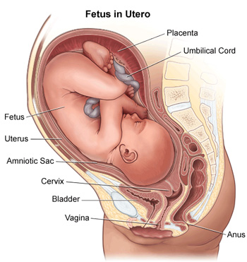
Gynaecology and Obstetrics equipment
Equipment used in gynaecological investigations
Equipment used in labour and delivery
18.2.1 Identify the equipment used in a gynaecology and obstetrics unit
Unit C 18.2 Maintaining Gynaecology and Obstetrics equipment
Module 279 19 C Medical Instrumentation II
©
dr. Chris R. Mol, BME, NORTEC, 2015

Slide 2
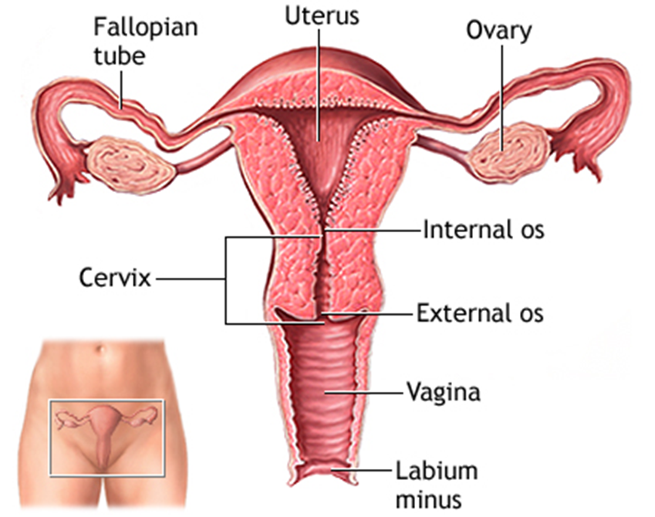
Gynaecology
Gynaecology is the medical practice dealing with the health of the female reproductive systems (vagina, uterus and ovaries) and the breasts. It also deals with issues like fertility, pregnancy and contraception.
Gynaecology means "the science of women". Its counterpart is andrology, which deals with medical issues specific to the male reproductive system.
©
Gynaecology and Obstetrics equipment
dr. Chris R. Mol, BME, NORTEC, 2015

Slide 3
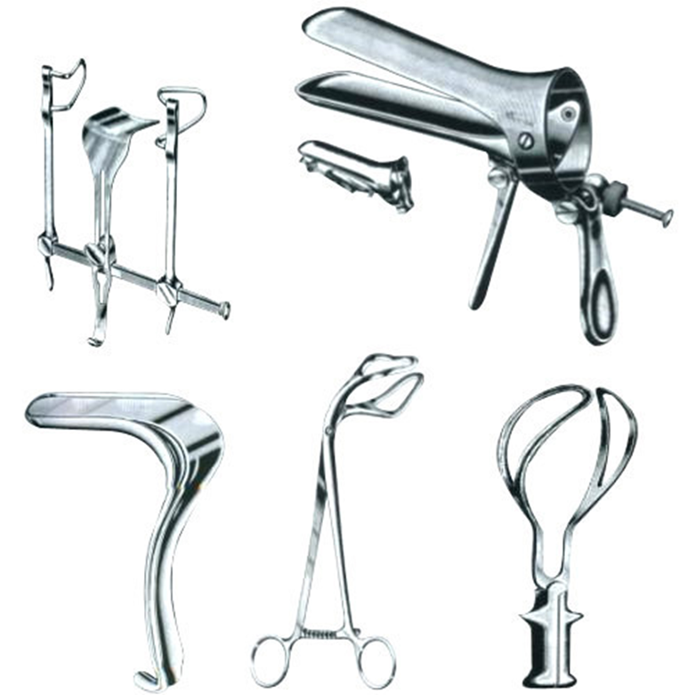
Gynaecological conditions
Conditions dealt with by a gynaecologist include:
Cancer of the reproductive organs
Incontinence of urine
Problems with the menstrual periods (absent, painful, heavy)
Infertility
Infections of the vagina (vaginitis), cervix and uterus
gynaecological tools
(not considered to be medical equipment)
©
Gynaecology and Obstetrics equipment
dr. Chris R. Mol, BME, NORTEC, 2015

Slide 4
Gynaecological therapies
As with all surgical specialties, gynaecologists may employ medical (drugs) or surgical therapies or both.
Standard drug therapies include antibiotics, diuretics, antihypertensives, etc. Additionally, gynaecologists make frequent use of specialized hormone therapies, such as hormonal contraception.
Surgery is the mainstay of gynaecological therapy. Some of the common operations include:
Dilation and curettage (removal of the uterine contents e.g. for completing a partial miscarriage)
Hysterectomy (removal of the uterus)
Oophorectomy (removal of the ovaries)
Tubal ligation (a type of permanent sterilization)
Hysteroscopy (inspection of the uterine cavity)
Diagnostic laparoscopy – used to diagnose and treat sources of pelvic and abdominal pain
©
Gynaecology and Obstetrics equipment
dr. Chris R. Mol, BME, NORTEC, 2015

Slide 5
Obstetrics
Obstetrics is the medical profession that deals with pregnancy, childbirth, and the postpartum period (including care of the new-born).
As a medical specialty, obstetrics is combined with gynaecology under the discipline known as obstetrics and gynaecology (OB/GYN). Almost all gynaecologists are also obstetricians.
Midwifery is an associated health profession. Traditionally, midwifes focus on support of childbirth and are not as highly trained as ob/gyn specialists.
©
Gynaecology and Obstetrics equipment
dr. Chris R. Mol, BME, NORTEC, 2015

Slide 6
Obstetrics
Pre-natal care is important in screening for compli-cations. This can include routine office visits with physical exams and routine lab tests such as: ultrasound, blood analysis, venereal disease, HIV, Down’s syndrome, …
Induction is a method of prematurely stimulating labour in a woman, for clinical reasons, by means of drugs. Induction may occur any time after 34 weeks of gestation if the risk to the fetus or mother is greater than the risk of delivering a premature fetus.
During labor, the obstetrician monitors progress, provides pain relief, surgically assists the labor, by forceps or the vacuum extractor of Caesarean section (see chart).
©
Gynaecology and Obstetrics equipment
dr. Chris R. Mol, BME, NORTEC, 2015

Slide 7
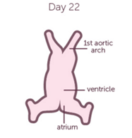
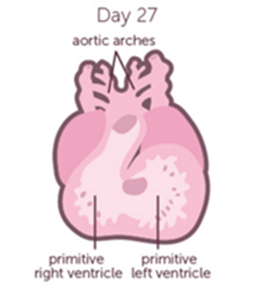
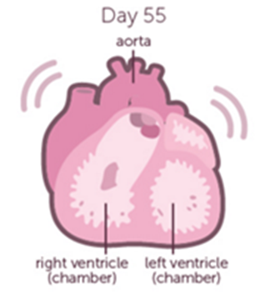
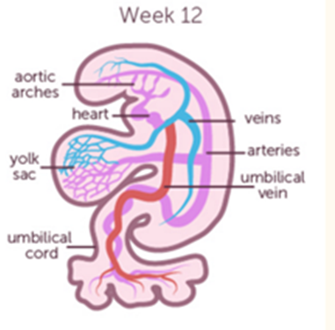
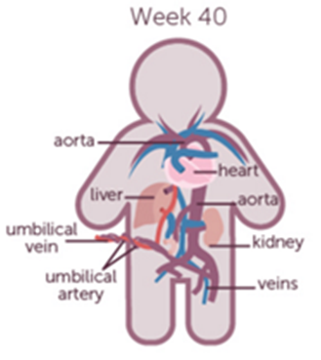
Fetal cardiac development
The Heart and Circulatory System are among the first organs to develop in the fetus;
they normally appear during the 3rd or 4th week of life.
The heart rate is also one of the easiest parameters to measure in a fetus.
©
Vital Signs
dr. Chris R. Mol, BME, NORTEC, 2015

Slide 8
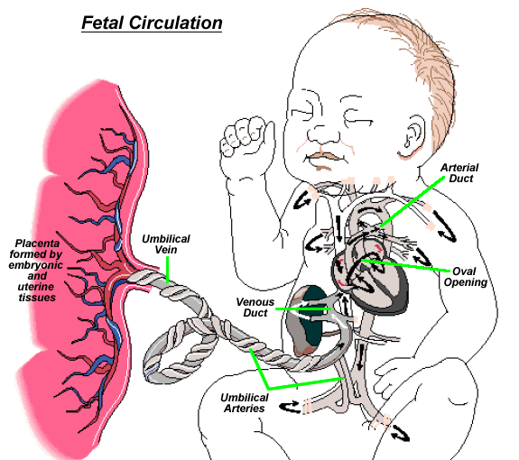
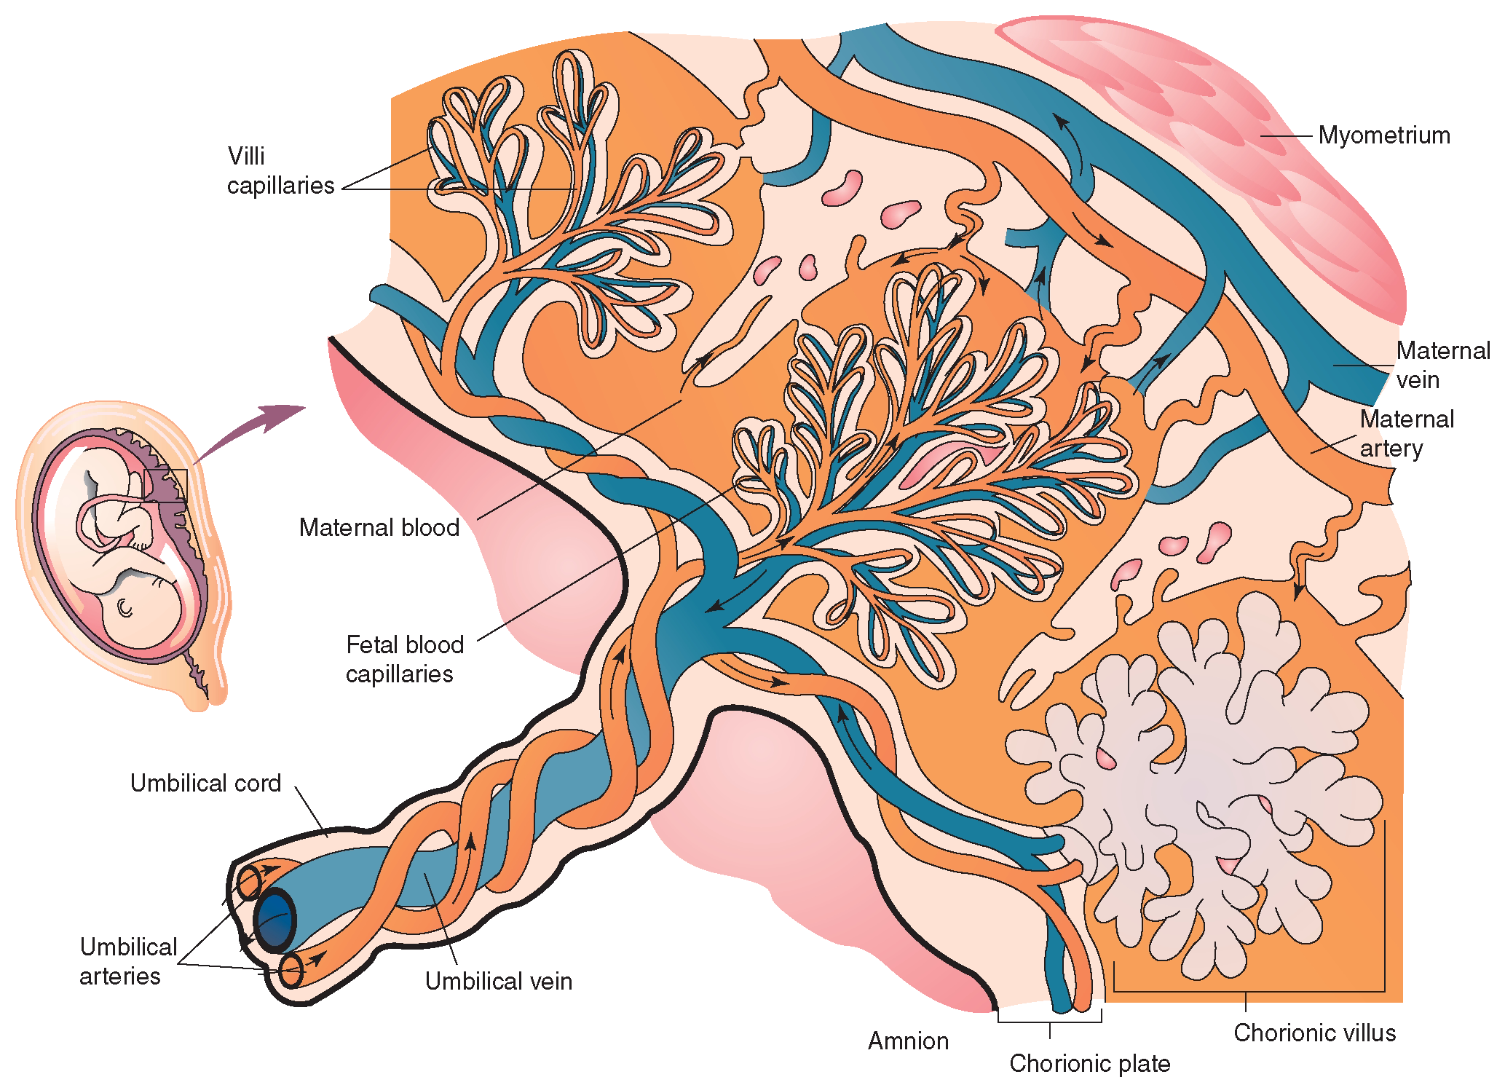
Fetal circulation and placenta (maternal circulation)
ar during the 3rd or 4th week of life.
detail of umbilical cord (vein, arteries) and placenta
©
Vital Signs
dr. Chris R. Mol, BME, NORTEC, 2015

Slide 9
Fetal cardiac development: disease
About 1 in 125 babies has a – more or less serious - heart defect at birth. This is called ‘Congenital Heart Disease’ (CHD).
Common examples of CHD are the Atrial Septal Defect and the Ventricular Septal Defect where a defect (‘hole’)
in the muscle between left and right heart chambers (the ‘septum’) causes inefficient pump function of the heart.
©
Vital Signs
dr. Chris R. Mol, BME, NORTEC, 2015

Slide 10
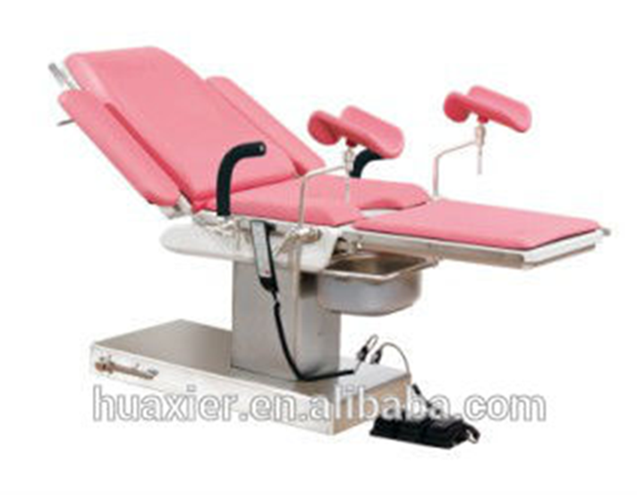
Equipment used in gynaecology (next to that used during general surgery)
©
Gynaecology and Obstetrics equipment
dr. Chris R. Mol, BME, NORTEC, 2015

Slide 11
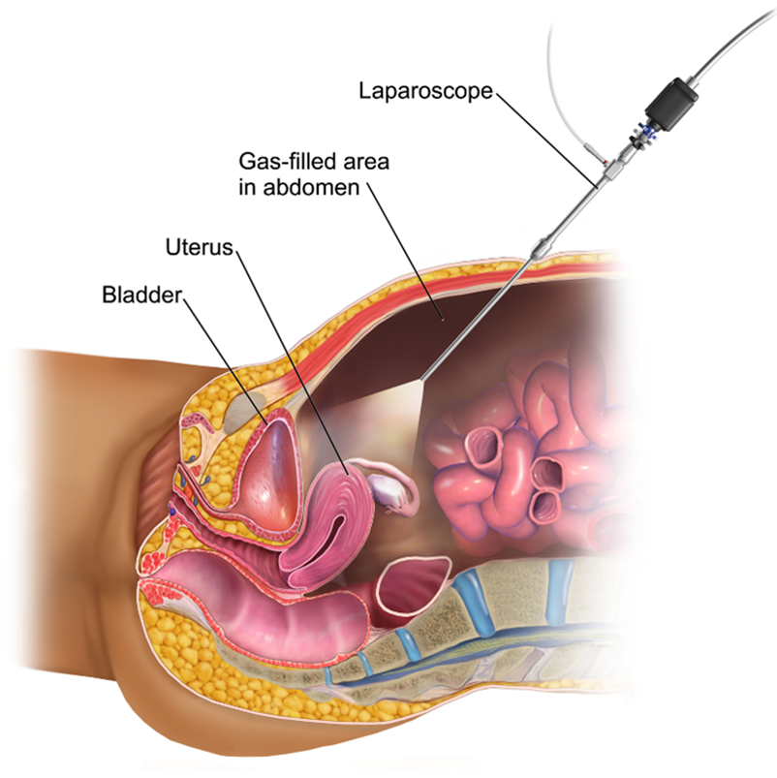
Laparoscope
During laparoscopy, the surgeon makes one or more small incisions in the abdomen. These allow the surgeon to insert the laparoscope, small surgical tools.
See lecture on Endoscopy in Med. Instrumentation I
©
Gynaecology and Obstetrics equipment
dr. Chris R. Mol, BME, NORTEC, 2015

Slide 12
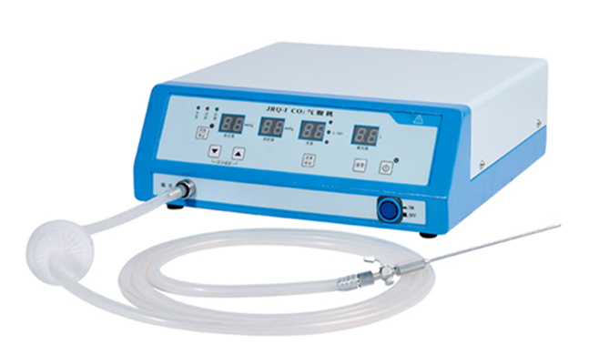
Insufflator
An insufflator (Latin insufflatio "blowing on" or "into") is used to blow an inert gas into the abdominal cavity to expand workroom ro reduce obstruction. Pressure and volume of the gas can be controlled.
©
Gynaecology and Obstetrics equipment
dr. Chris R. Mol, BME, NORTEC, 2015

Slide 13
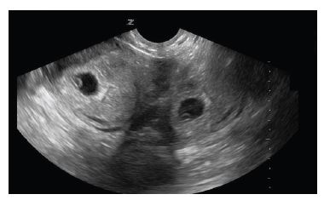
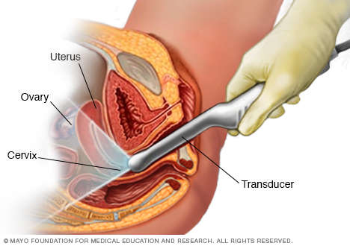
Vaginal ultrasound
Longitudinal transvaginal ultrasound demonstrating intrauterine pregnancy on the left
further discussed during Imaging lectures
©
Gynaecology and Obstetrics equipment
dr. Chris R. Mol, BME, NORTEC, 2015

Slide 14
Equipment used in obstetrics
©
Gynaecology and Obstetrics equipment
dr. Chris R. Mol, BME, NORTEC, 2015

Slide 15
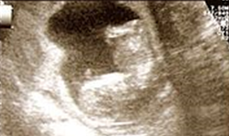
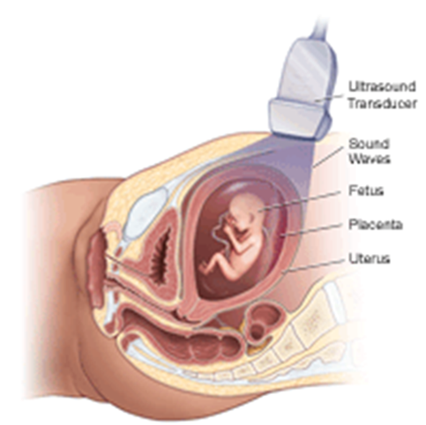
Transabdominal ultrasound imaging during pregnancy
Ultrasound imaging is an important way to monitor a pregnancy. This is done to:
A ‘dating scan’ at 12 weeks.
predict problems with the mother;
confirm that a pregnancy is present inside the uterus;
estimate the gestational age;
determine the number of foetuses and placentae;
evaluate for an ectopic pregnancy and first trimester bleeding;
assess for early signs of anomalies.
This test is not painful and causes no harm to the baby.
Ultrasound imaging may be done at any time throughout the pregnancy, but usually happens at the 12th week (dating scan) and the 20th week (detailed scan).
Ultrasound imaging is ideal for this purpose since it emits no radiation, is portable, and allows for real-time imaging. Further detail will be discussed during Imaging Equipment in Term 9
©
Gynaecology and Obstetrics equipment
dr. Chris R. Mol, BME, NORTEC, 2015

Slide 16
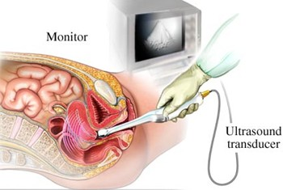
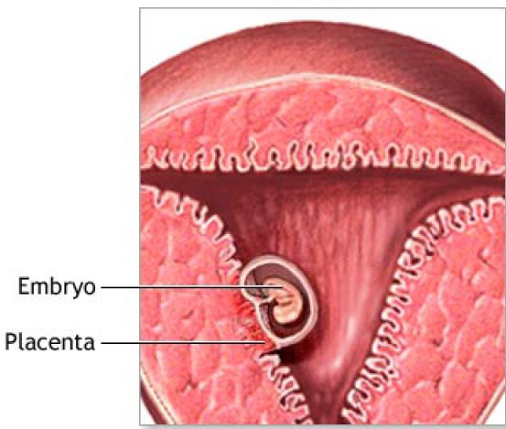
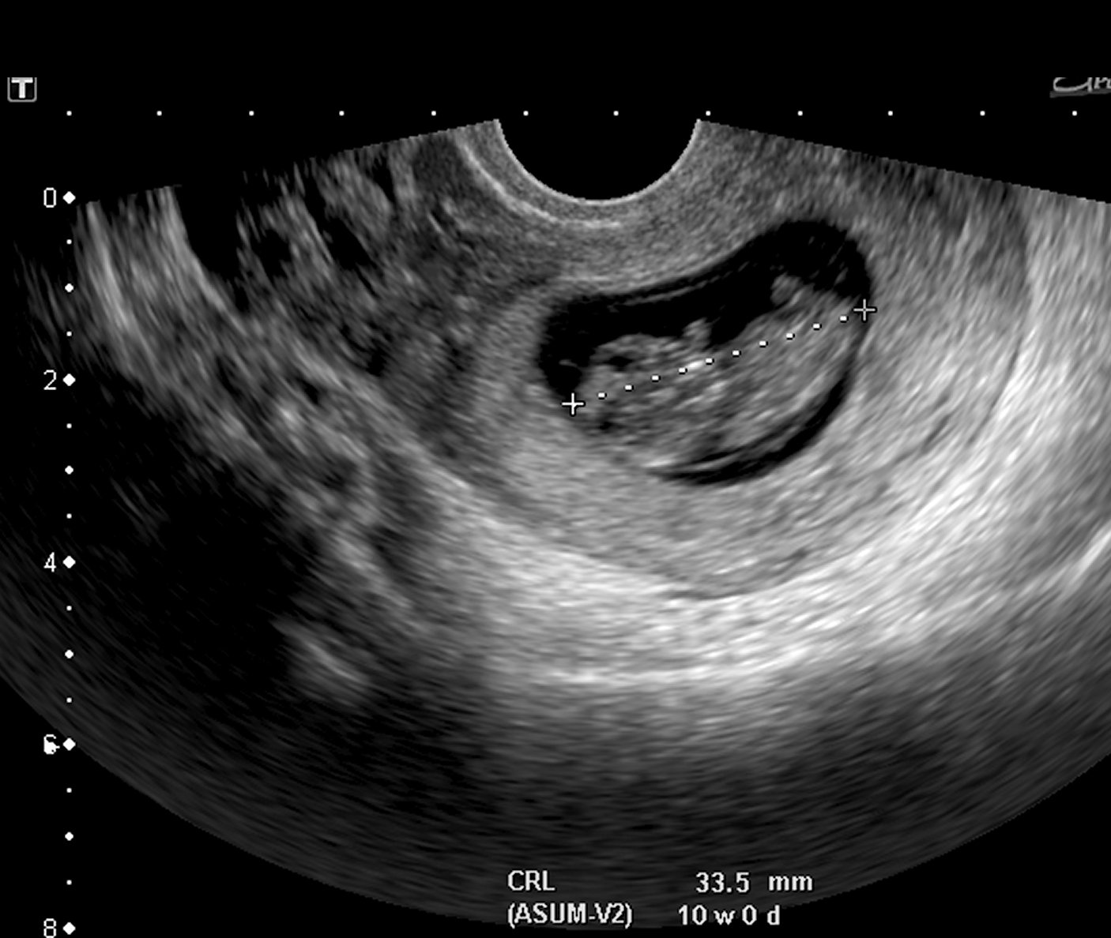
Endo-vaginal ultrasound imaging during pregnancy
Endo-vaginal ultrasound: this ultrasound is typically used early in pregnancy. A small ultrasound transducer is inserted into the vagina and rests against the back of the vagina. Pictures can then be taken of the baby's heart as early as 12 weeks into the pregnancy.
©
Vital Signs
dr. Chris R. Mol, BME, NORTEC, 2015

Slide 17
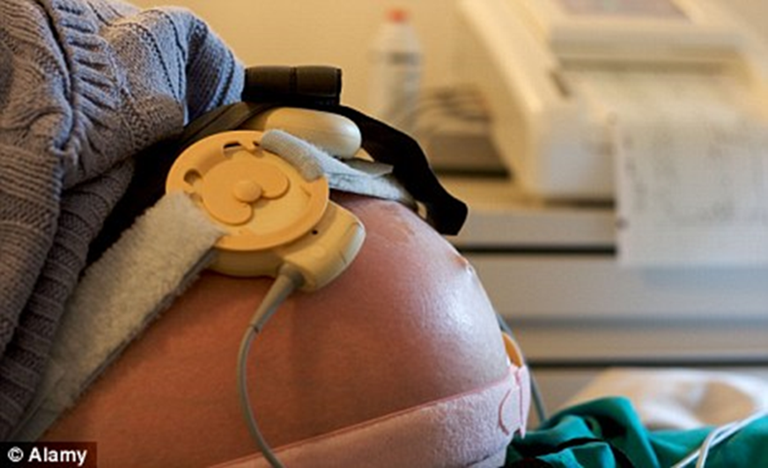
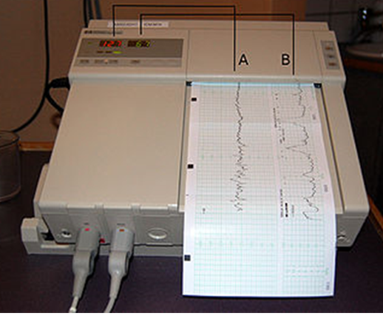
Foetal (heart) monitor
With a fetal heart rate monitor you can measure:
the heart rate of the fetus
the strength and duration of uterine contractions of the mother during labour
A normal fetal heart rate is between 110 to 160 beats a minute. The beat is usually strong and regular. It is normal to have some changes in the fetal heart rate during labor, but drastic changes in heart rate before or after a contraction may indicate that the fetus is in distress.
A fetus with large changes in heart rate may need to be removed from the womb immediately, by Caesarean section.
©
Gynaecology and Obstetrics equipment
dr. Chris R. Mol, BME, NORTEC, 2015

Slide 18
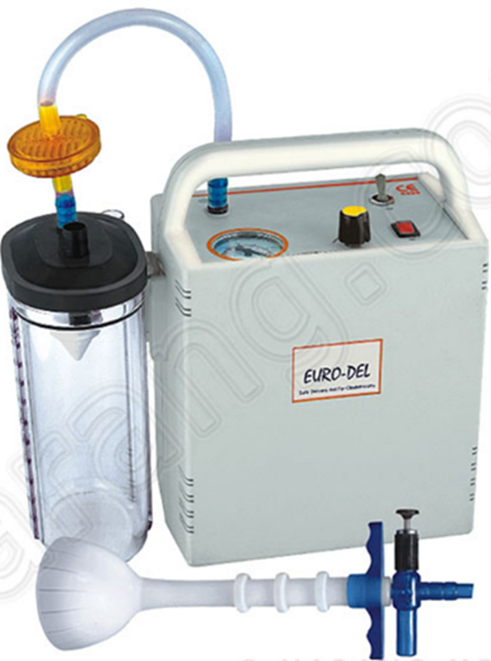
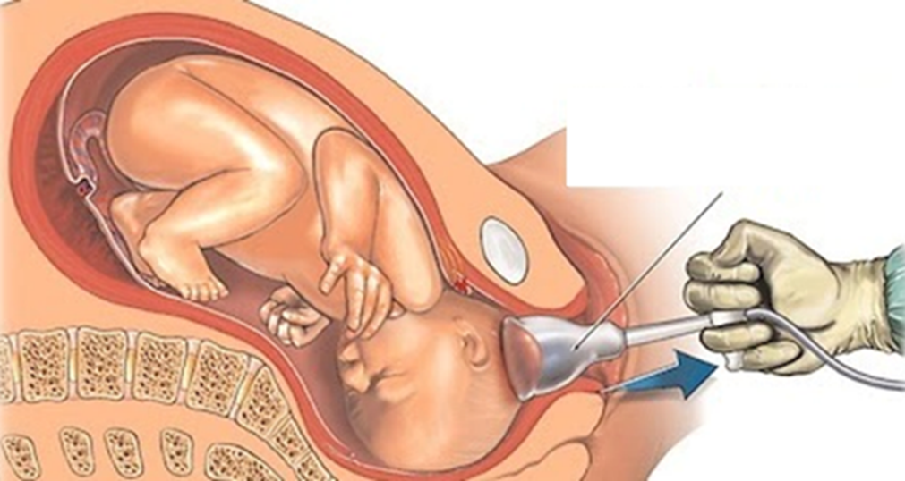
Vacuum extractor and pump
A vacuum extraction is a procedure sometimes (5% of cases in the US) done during the course of vaginal childbirth, especially if labor isn't progressing or if the baby's health depends on an immediate delivery.
During vacuum extraction, a vacuum is applied to the baby's head to help guide the baby out of the birth canal. This is typically done during a contraction while the mother pushes.
©
Gynaecology and Obstetrics equipment
dr. Chris R. Mol, BME, NORTEC, 2015

Slide 19
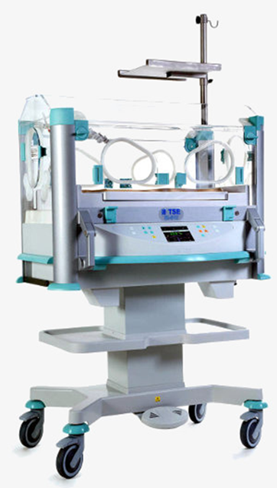
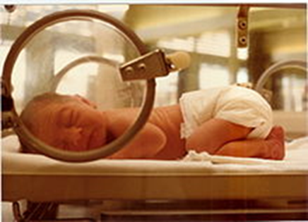
Incubator
An Infant incubator is a chamber which provides a protective, isolated environment for new-born babies. These include pre-mature babies (born too early) which are still small and weak as well as unhealthy full-term babies.
The incubator consists of a transparent cabinet in which the baby is kept in an environment with optimal temperature and moisture, where the baby needs minimal energy to maintain normal body temperature.
©
Gynaecology and Obstetrics equipment
dr. Chris R. Mol, BME, NORTEC, 2015

Slide 20
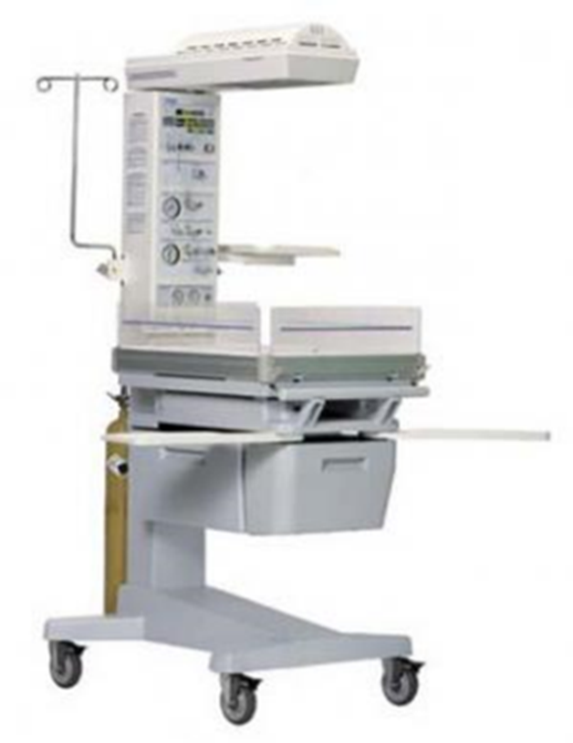
Resuscitaire
A resuscitaire creates a controlled environment to give intensive care to a new-born child who may experience some difficulties. E.g. the baby may not breath well, maybe due to inadequate oxygenation of the mother’s blood …
​Environmental factors that are controlled:
temperature
humidity
oxygen
light
The unit includes a
suction unit
ventilator
gas flow meter
and optionally more…..
©
Gynaecology and Obstetrics equipment
dr. Chris R. Mol, BME, NORTEC, 2015

Slide 21
END
The creation of this presentation was supported by a grant from THET:
see https://www.thet.org/

